Slide 1
Media Analysis Assignment Summary
Spring 2022

Slide 2
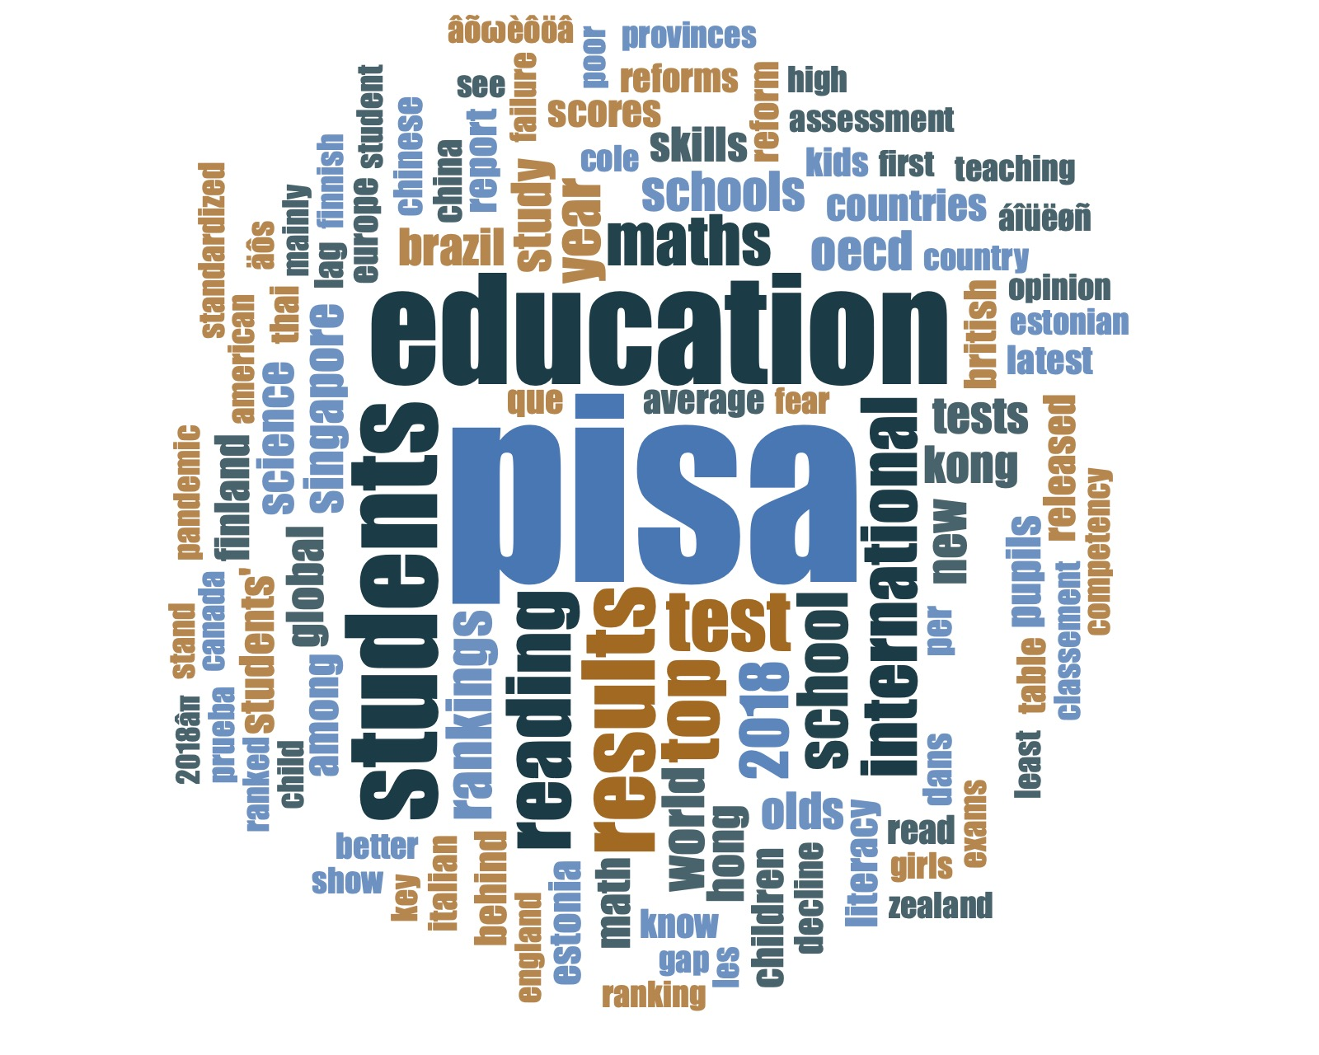
Notes:
Word Cloud of Titles

Slide 3
Countries coded (n=14)
Australia (10)
Brazil (10)
Canada (10)
China – Hong Kong (10)
China – BSJZ (10)
Estonia (8)
Finland (9)
France (10)
Indonesia (10)
Italy (11)
New Zealand (14)
Peru (10)
Singapore (10)
Thailand (10)
United Kingdom (20)
United States (7)
Notes:
US and China – OTHERS coded by two different people

Slide 4
Media attention, by day/date
PISA 2018 Release Date

Slide 5
Media attention, by location
Local news, online, forums, etc.

Slide 6
Visuals

Slide 7
What kind of visuals?

Slide 8
How does the article (in what form) present PISA results?

Slide 9
Does the article provide description and/or details about PISA?

Slide 10
What aspects of PISA are mentioned?

Slide 11
Focus of the article?

Slide 12
Percent of articles…
Examples?

Slide 13
Overall tone of the article

Slide 14
Overall tone and policy

Slide 15
Overall tone, by country

Slide 16
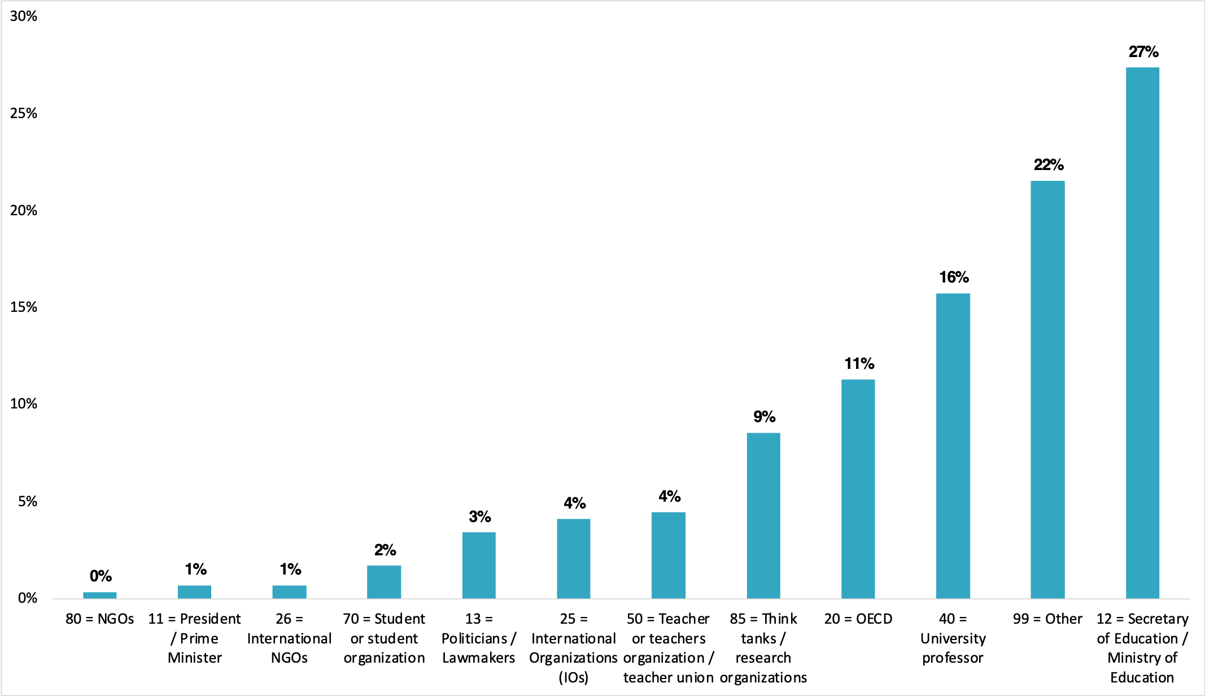
Who Are The Speakers?

Slide 17
Reference to Other Societies

Slide 18
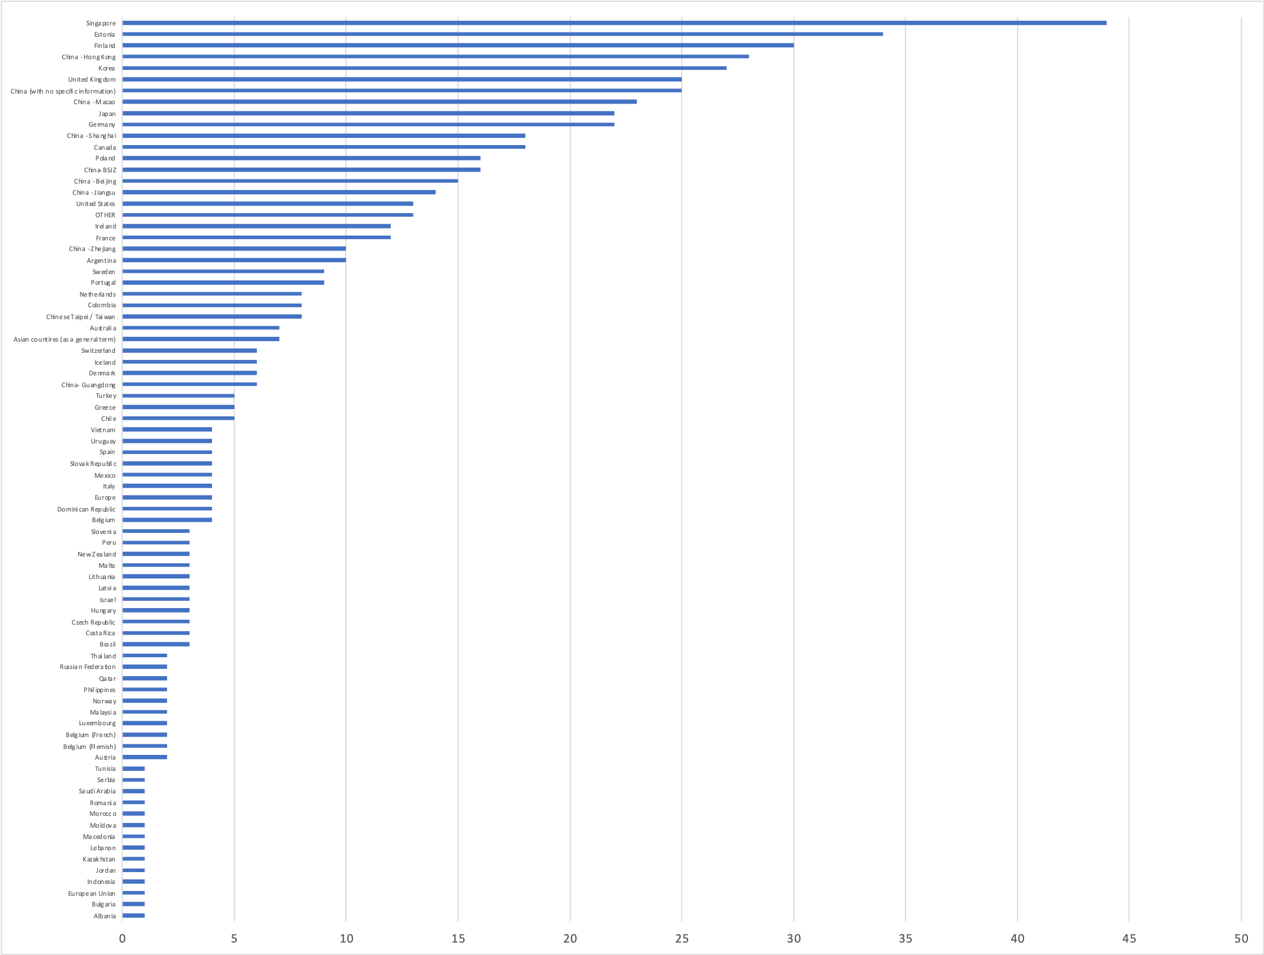
Reference Societies (Whole)

Slide 19
Reference Societies (Top References)

